Slide 1

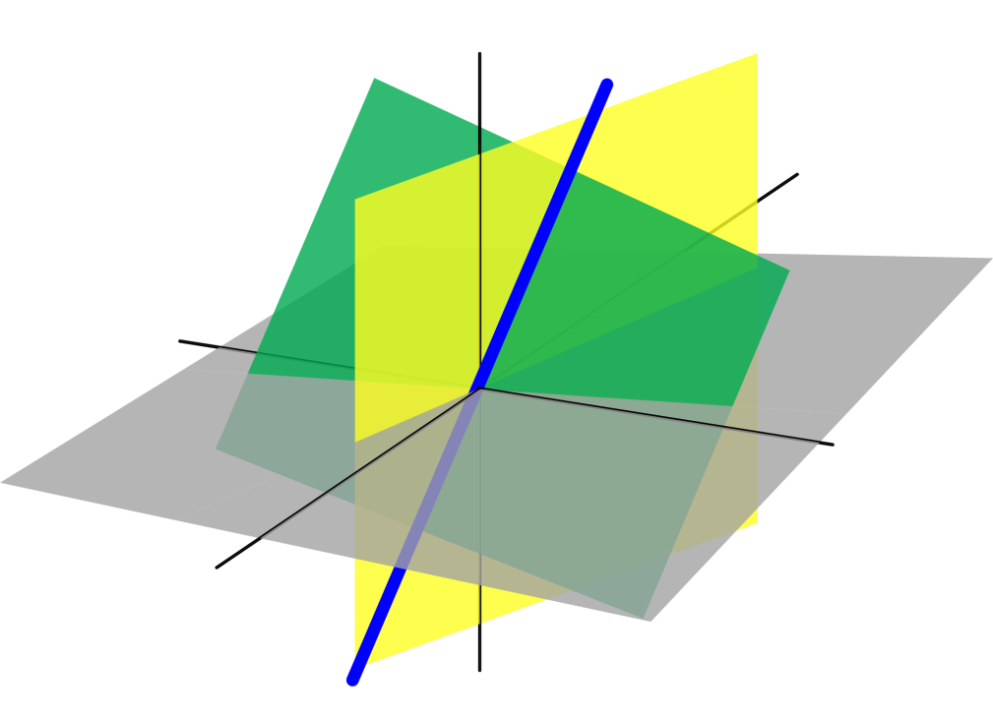
Azərbaycan Dövlət Neft və Sənaye Universiteti
Linear Algebra

Slide 2
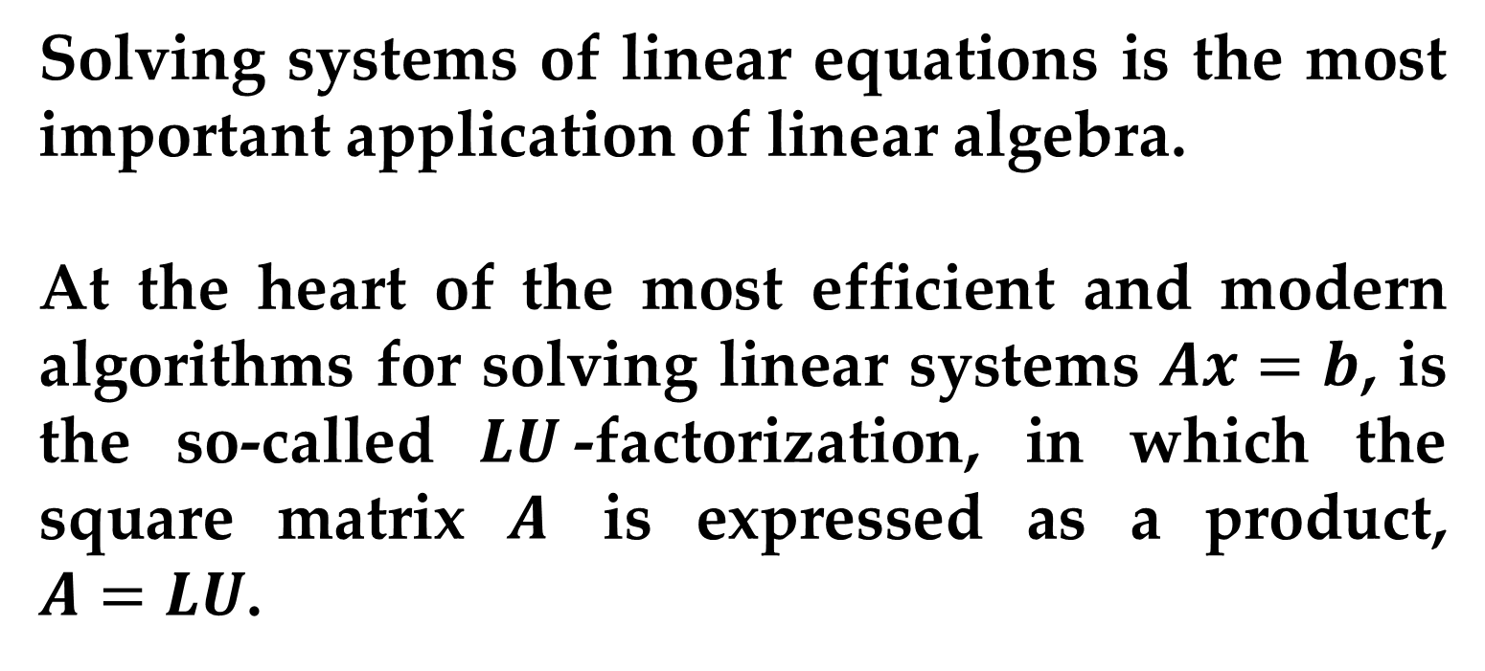
Introduction
Solving systems of linear equations is the most important application of linear algebra.
At the heart of the most efficient and modern algorithms for solving linear systems $Ax=b$, is the so-called $LU$-factorization, in which the square matrix $A$ is expressed as a product, $A=LU$.
LU – Factorization

Slide 3
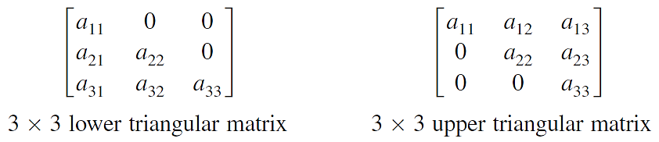
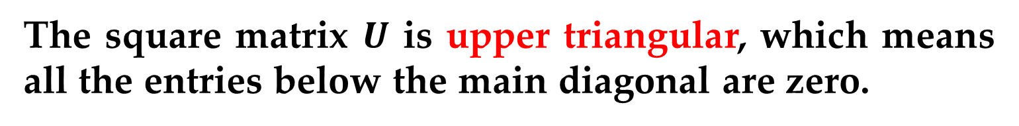
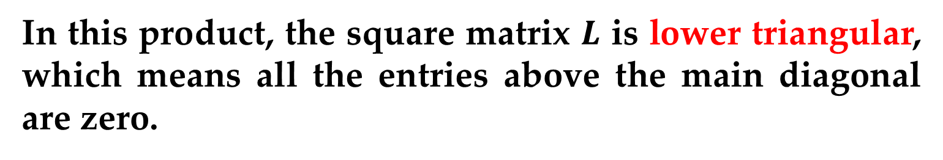
Introduction
In this product, the square matrix $L$ is lower triangular, which means all the entries above the main diagonal are zero.
The square matrix $U$ is upper triangular, which means all the entries below the main diagonal are zero.

Slide 4

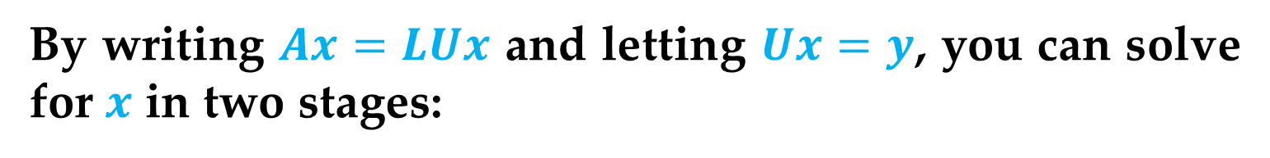
Introduction
By writing $Ax=LUx$ and letting $Ux=y$, you can solve for $x$ in two stages:
First solve $Ly=b$ for $y$.
Then solve $Ux=y$ for $x$.
Each system is easy to solve because the coefficient matrices are triangular.
In particular, neither system requires any row operations.

Slide 5

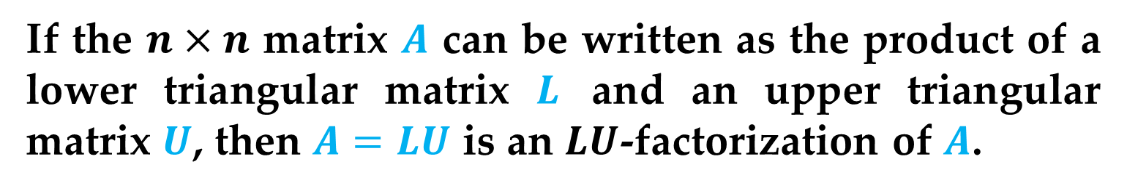
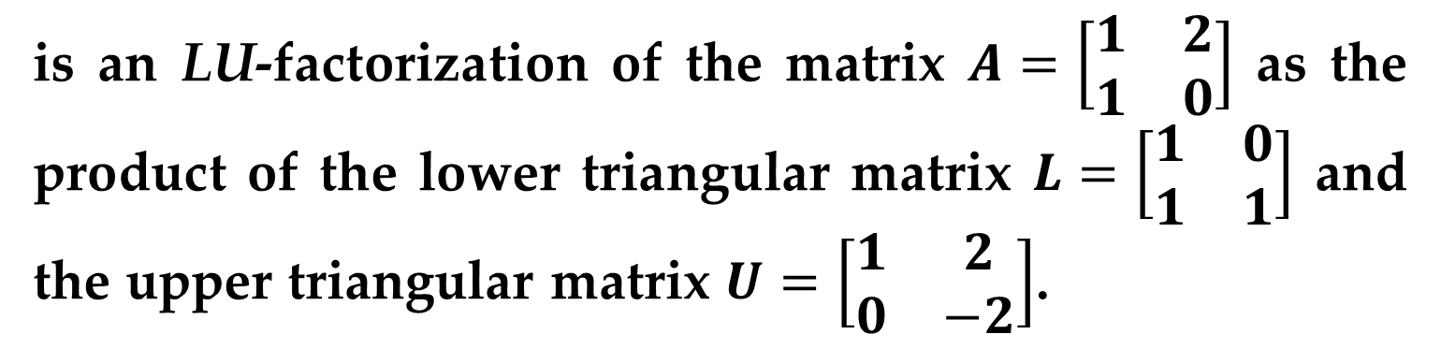
Introduction
Definition ($LU$-Factorization)
If the $n×n$ matrix $A$ can be written as the product of a lower triangular matrix $L$ and an upper triangular matrix $U$, then $A=LU$ is an $LU$-factorization of $A$.
Example 1 ($LU$-Factorizations)
is an LU-factorization of the matrix $A=\left[\begin{matrix}1 & 2 \\ 1 & 0\end{matrix}\right]$ as the product of the lower triangular matrix $L=\left[\begin{matrix}1 & 0 \\ 1 & 1\end{matrix}\right]$ and the upper triangular matrix $U=\left[\begin{matrix}1 & 2 \\ 0 & −2\end{matrix}\right]$.

Slide 6
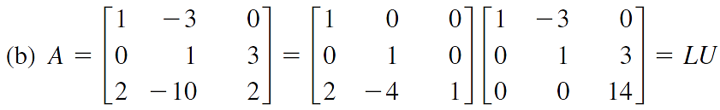
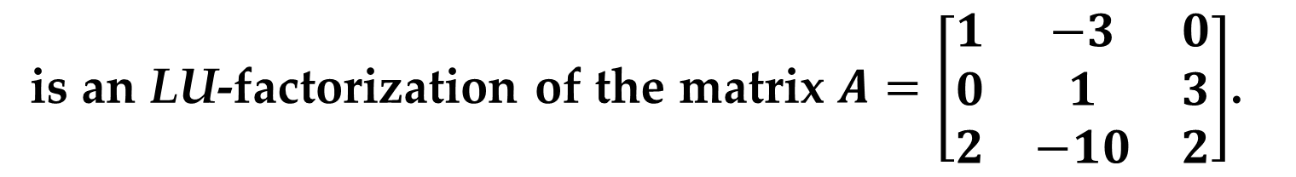
Introduction
Example 1 ($LU$-Factorizations) (continued)
is an LU-factorization of the matrix $A=\left[\begin{matrix}1 & −3 & 0 \\ 0 & 1 & 3 \\ 2 & −10 & 2\end{matrix}\right]$.

Slide 7
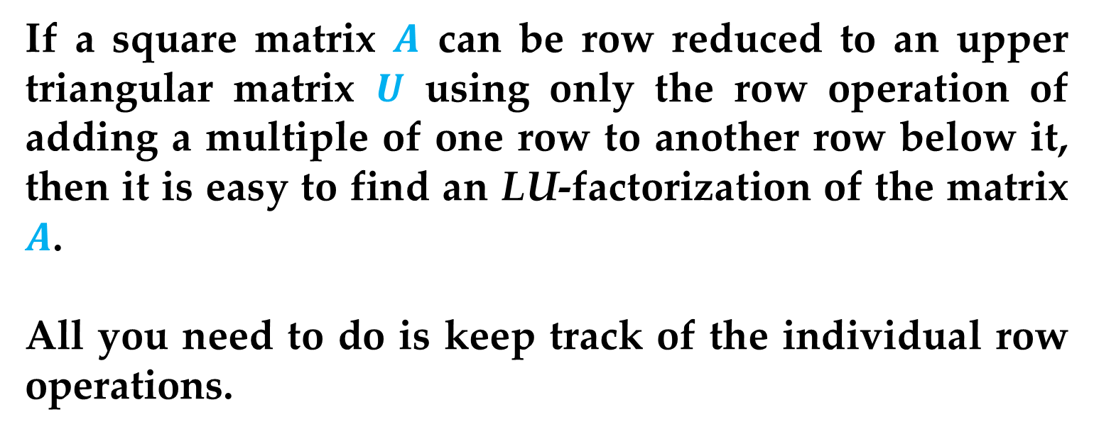
Introduction
If a square matrix $A$ can be row reduced to an upper triangular matrix $U$ using only the row operation of adding a multiple of one row to another row below it, then it is easy to find an LU-factorization of the matrix $A$.
All you need to do is keep track of the individual row operations.
LU-factorization of a matrix is accomplished using Elementary Matrices.

Slide 8
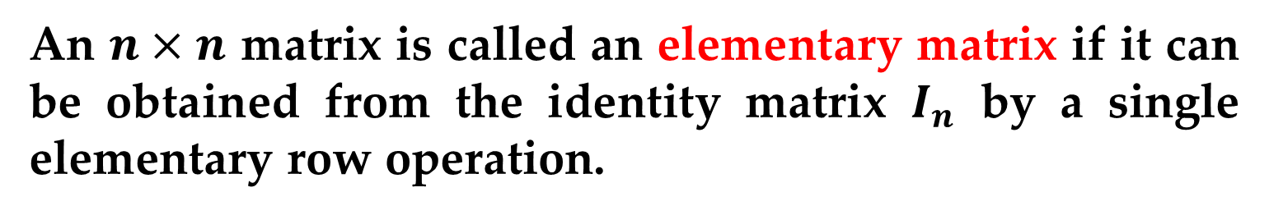
Elementary Matrices
We have already introduced three elementary row operations for matrices, which are listed below:
1. Interchange two rows.
2. Multiply a row by a nonzero constant.
3. Add a multiple of a row to another row.
Now you will see how matrix multiplication can be used to perform these operations.
Definition (Elementary Matrix)
An $n×n$ matrix is called an elementary matrix if it can be obtained from the identity matrix $I_{n}$ by a single elementary row operation.

Slide 9
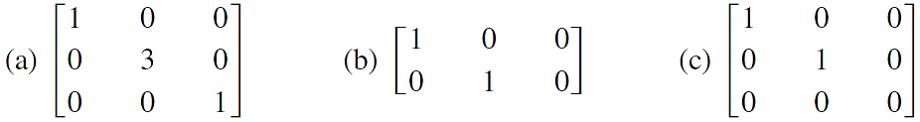
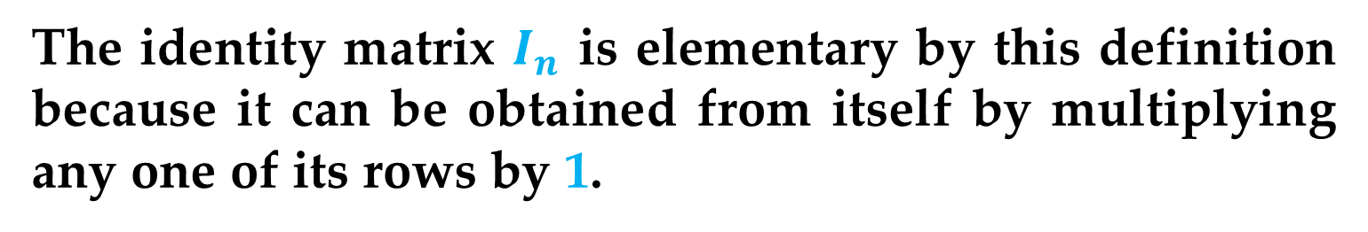
Elementary Matrices
Remark
The identity matrix $I_{n}$ is elementary by this definition because it can be obtained from itself by multiplying any one of its rows by 1.
Example 2 (Elementary Matrices and Nonelementary Matrices)
Which of the following matrices are elementary? For those that are, describe the corresponding elementary row operation.

Slide 10
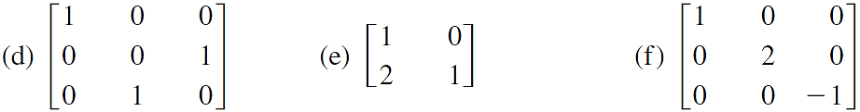
Elementary Matrices
Example 2 (Elementary Matrices and Nonelementary Matrices)
Elementary matrices are useful because they enable you to use matrix multiplication to perform elementary row operations, as demonstrated in Example 3.

Slide 11
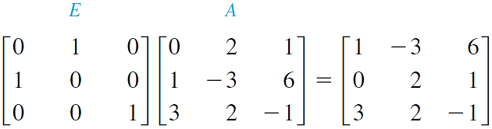

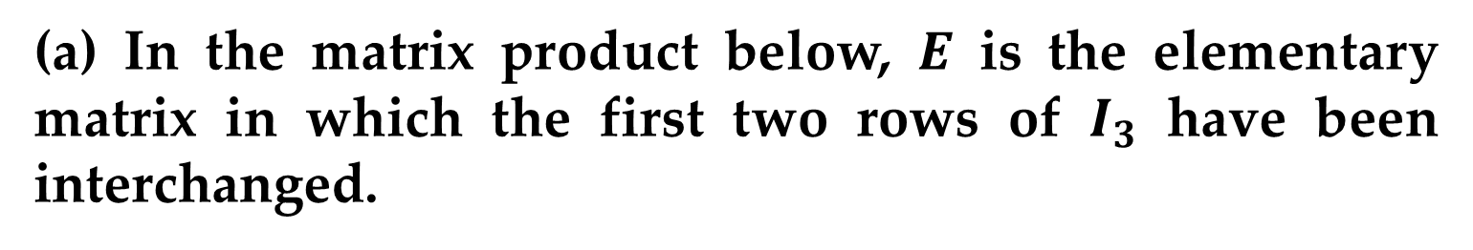
Elementary Matrices
Example 3 (Elementary Matrices and Elementary Row Operations)
(a) In the matrix product below, $E$ is the elementary matrix in which the first two rows of $I_{3}$ have been interchanged.
Note that the first two rows of $A$ have been interchanged by multiplying on the left by $E$.

Slide 12
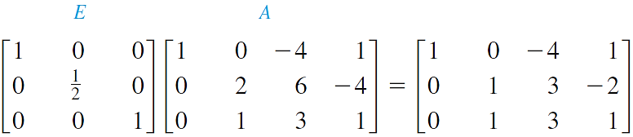
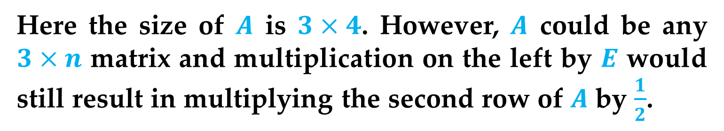
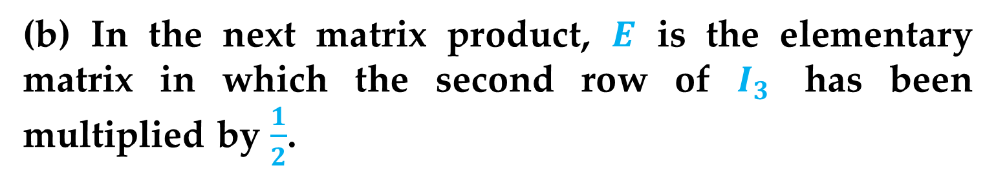
Elementary Matrices
Example 3 (Elementary Matrices and Elementary Row Operations) (continued)
(b) In the next matrix product, $E$ is the elementary matrix in which the second row of $I_{3}$ has been multiplied by $\frac{1}{2}$.
Here the size of $A$ is $3×4$. However, $A$ could be any $3×n$ matrix and multiplication on the left by $E$ would still result in multiplying the second row of $A$ by $\frac{1}{2}$.

Slide 13
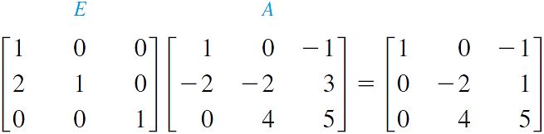
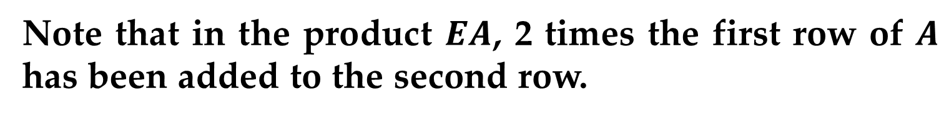
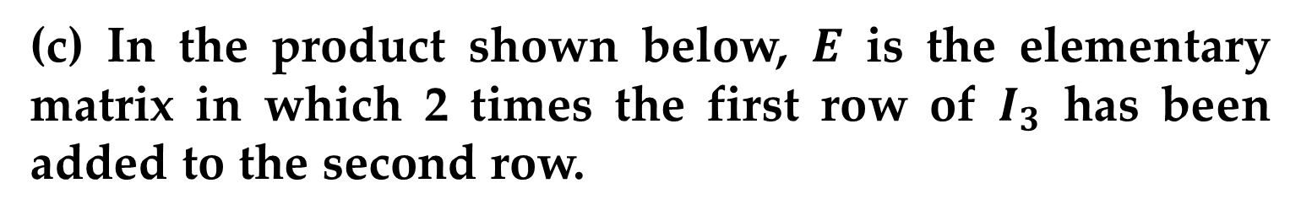
Elementary Matrices
Example 3 (Elementary Matrices and Elementary Row Operations) (continued)
(c) In the product shown below, $E$ is the elementary matrix in which 2 times the first row of $I_{3}$ has been added to the second row.
Note that in the product $EA$, 2 times the first row of $A$ has been added to the second row.

Slide 14
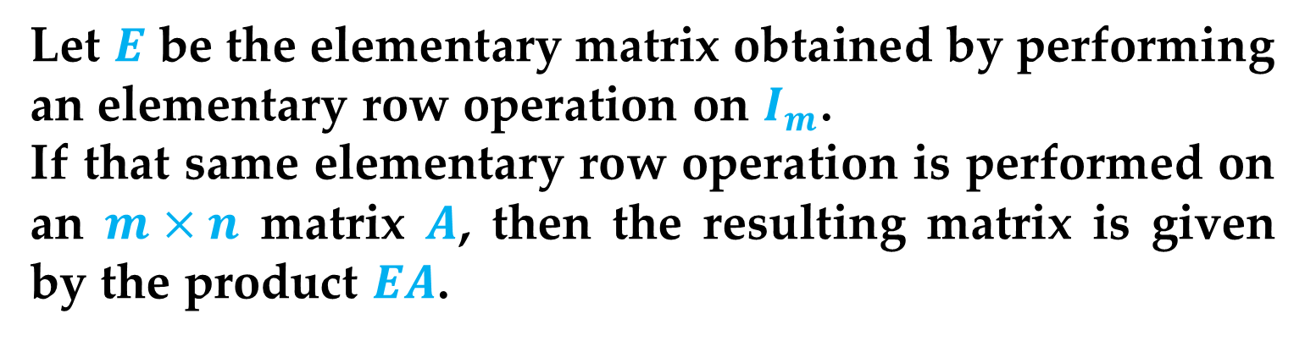
Elementary Matrices
Theorem (Representing Elementary Row Operations)
Let $E$ be the elementary matrix obtained by performing an elementary row operation on $I_{m}$.
If that same elementary row operation is performed on an $m×n$ matrix $A$, then the resulting matrix is given by the product $EA$.

Slide 15
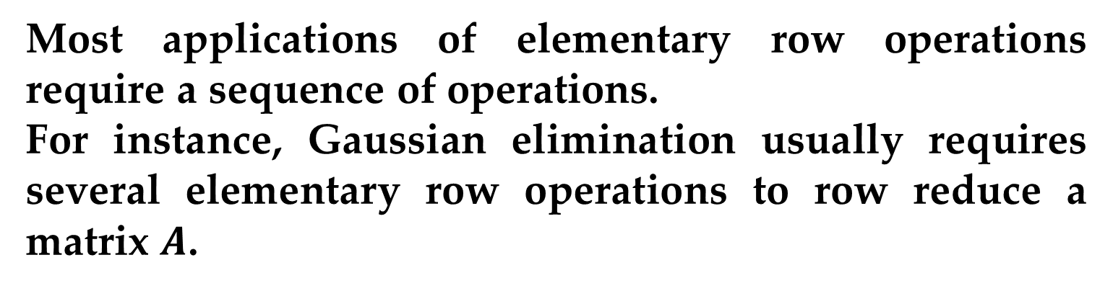
Elementary Matrices
Most applications of elementary row operations require a sequence of operations.
For instance, Gaussian elimination usually requires several elementary row operations to row reduce a matrix $A$.
For elementary matrices, this sequence translates into multiplication (on the left) by several elementary matrices.
The order of multiplication is important.
This process is demonstrated in Example 4.

Slide 16
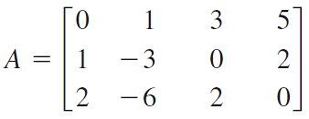
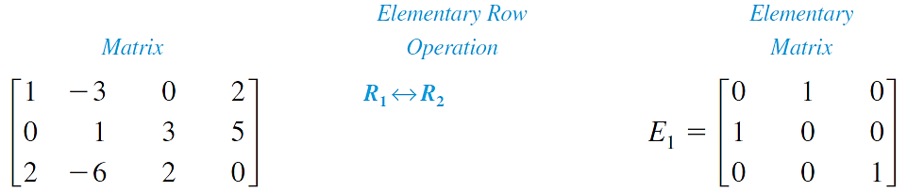
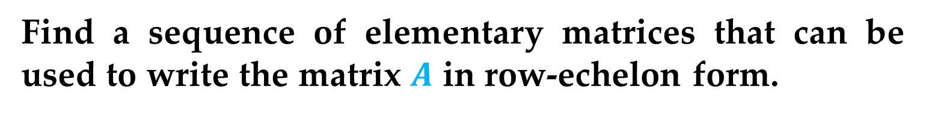
Elementary Matrices
Example 4 (Using Elementary Matrices)
Find a sequence of elementary matrices that can be used to write the matrix $A$ in row-echelon form.
Solution

Slide 17
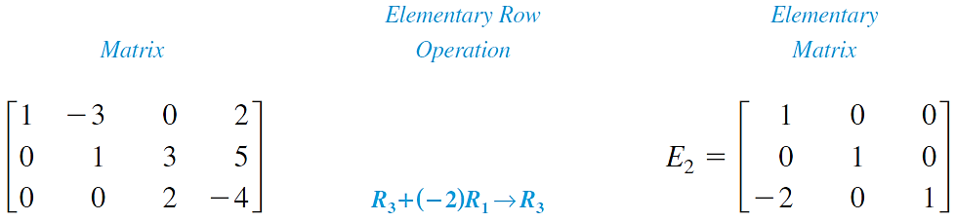
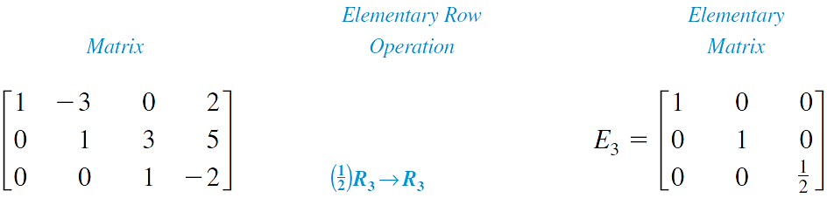
Elementary Matrices
Solution (continued)

Slide 18
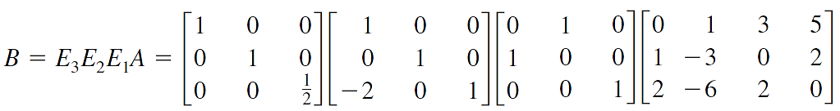
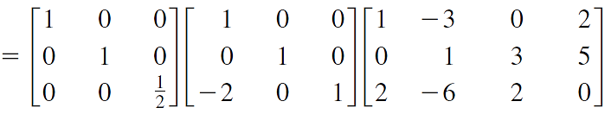
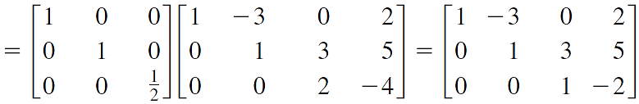
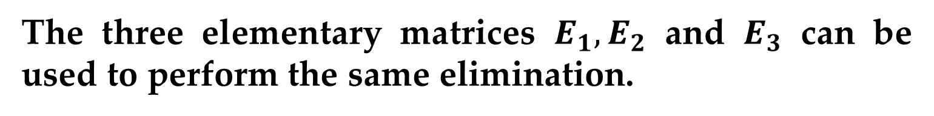
Elementary Matrices
Solution (continued)
The three elementary matrices $E_{1}, E_{2}$ and $E_{3}$ can be used to perform the same elimination.

Slide 19
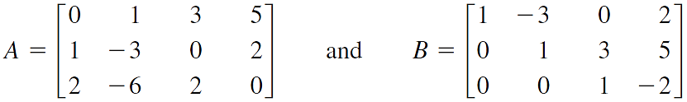
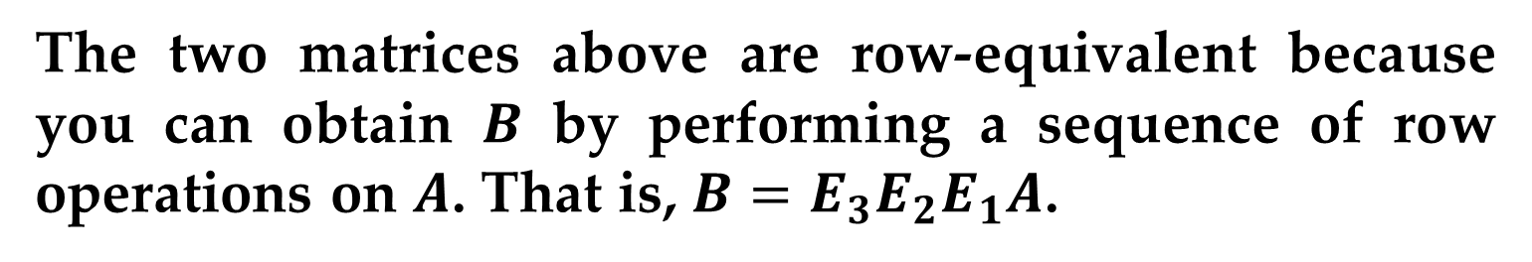
Elementary Matrices
Remark
The procedure demonstrated in Example 4 is primarily of theoretical interest.
In other words, this procedure is not suggested as a practical method for performing Gaussian elimination.
The two matrices above are row-equivalent because you can obtain $B$ by performing a sequence of row operations on $A$. That is, $B=E_{3}E_{2}E_{1}A$.

Slide 20
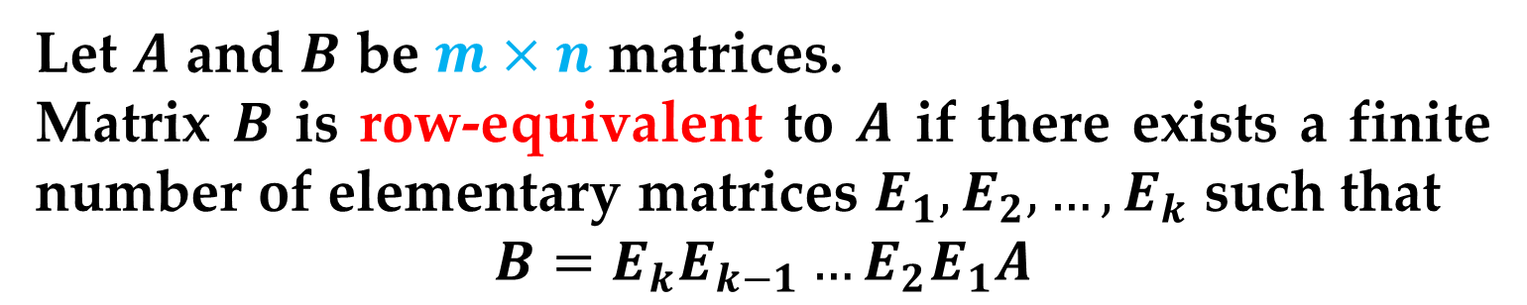
Elementary Matrices
Definition (Row Equivalence)
Let $A$ and $B$ be $m×n$ matrices.
Matrix $B$ is row-equivalent to $A$ if there exists a finite number of elementary matrices $E_{1}, E_{2},…,E_{k}$ such that
$$B=E_{k}E_{k−1}…E_{2}E_{1}A$$
Every elementary matrix, however, is invertible.
Moreover, the inverse of an elementary matrix is itself an elementary matrix.

Slide 21
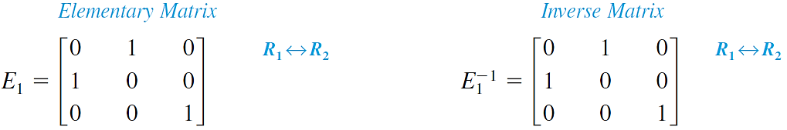
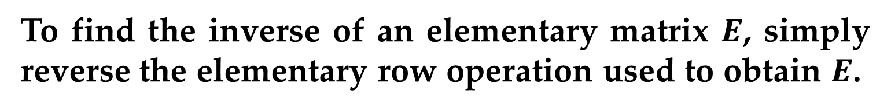
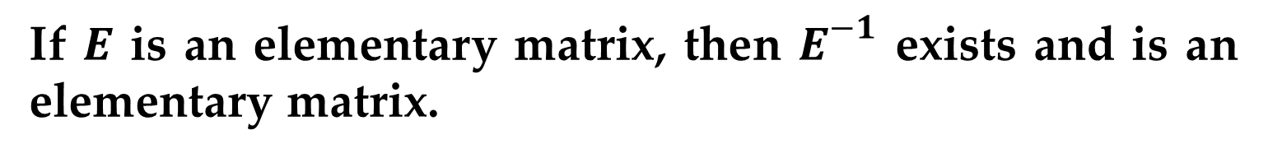
Elementary Matrices
Theorem (Elementary Matrices Are Invertible)
If $E$ is an elementary matrix, then $E^{−1}$ exists and is an elementary matrix.
To find the inverse of an elementary matrix $E$, simply reverse the elementary row operation used to obtain $E$.

Slide 22
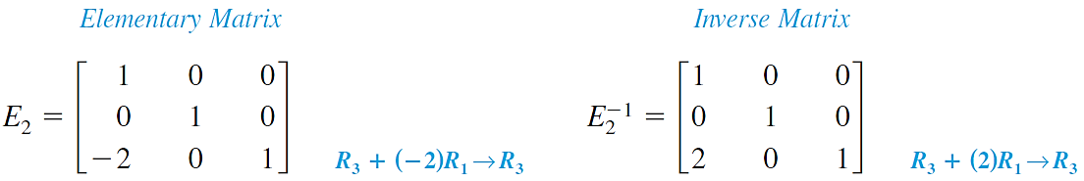
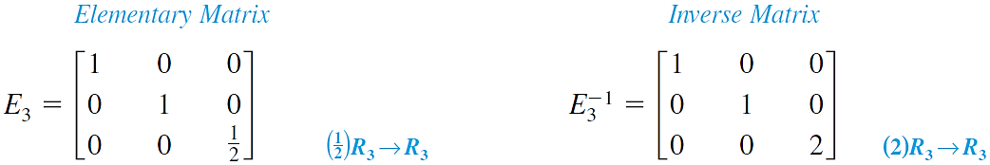
Elementary Matrices

Slide 23
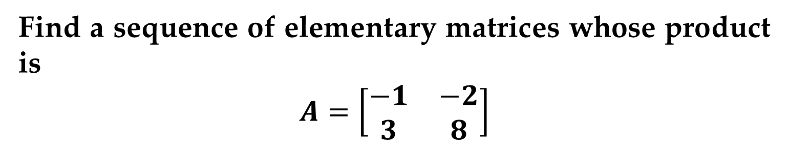
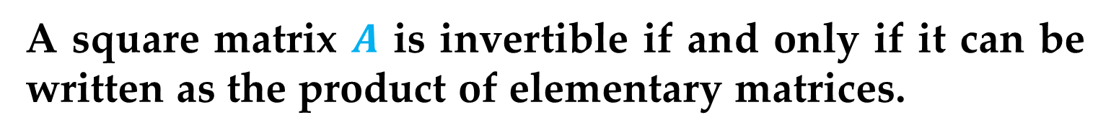
Elementary Matrices
Theorem (A Property of Invertible Matrices)
A square matrix $A$ is invertible if and only if it can be written as the product of elementary matrices.
Example 5 (Writing a Matrix as the Product of Elementary Matrices)
Find a sequence of elementary matrices whose product is
$$A=\left[\begin{matrix}−1 & −2 \\ 3 & 8\end{matrix}\right]$$

Slide 24
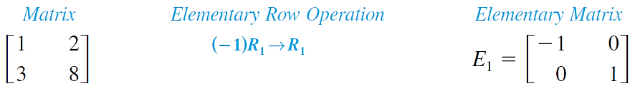
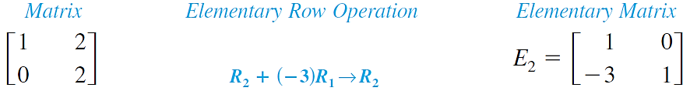
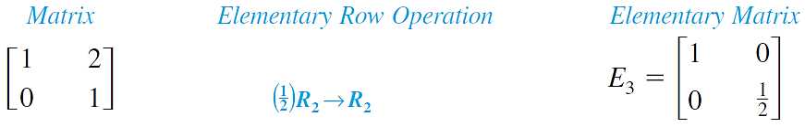
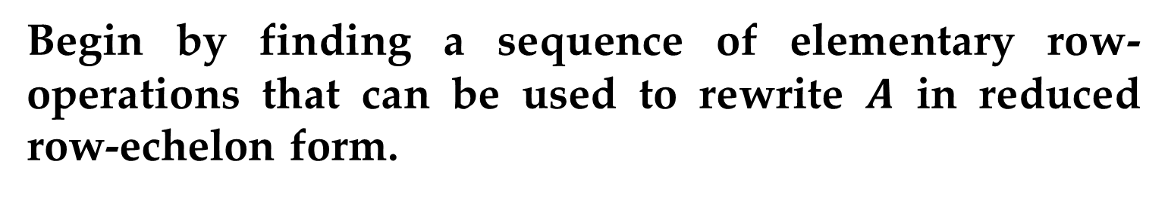
Elementary Matrices
Solution
Begin by finding a sequence of elementary row-operations that can be used to rewrite $A$ in reduced row-echelon form.

Slide 25
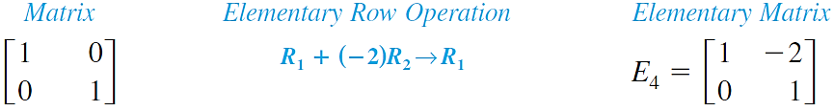
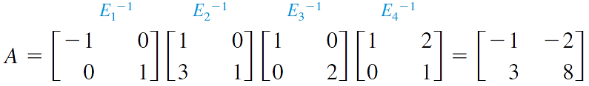

Elementary Matrices
Solution (continued)
Now, from the matrix product
$$E_{4}E_{3}E_{2}E_{1}A=I$$
solve for $A$ to obtain
$$A={E_{1}}_{}^{−1}{E_{2}}_{}^{−1}{E_{3}}_{}^{−1}{E_{4}}_{}^{−1}$$
This implies that $A$ is a product of elementary matrices:

Slide 26


Elementary Matrices
The next theorem ties together some important relationships between $n×n$ matrices and systems of linear equations.
Theorem (Equivalent Conditions)
If $A$ is an $n×n$ matrix, then the following statements are equivalent:
1. $A$ is invertible.
2. $Ax=b$ has a unique solution for every $n×1$ column matrix $b$.
3. $Ax=O$ has only the trivial solution.
4. $A$ is row-equivalent to $I_{n}$.
5. $A$ can be written as the product of elementary matrices.

Slide 27



LU – Factorization
Example 6 (Finding the LU-Factorizations of a Matrix)
Find the $LU$-factorization of the matrix
$$A=\left[\begin{matrix}1 & −3 & 0 \\ 0 & 1 & 3 \\ 2 & −10 & 2\end{matrix}\right]$$
Solution
Begin by row reducing $A$ to upper triangular form while keeping track of the elementary matrices used for each row operation.

Slide 28


LU – Factorization
Solution (continued)
The matrix on the left (which we will denote by $U$) is upper triangular, and it follows that $E_{2}E_{1}A=U$, or $A={E_{1}}_{}^{−1}{E_{2}}_{}^{−1}U$.

Slide 29


LU – Factorization
Solution (continued)
Because the product of the lower triangular matrices
is again a lower triangular matrix $L$, the factorization $A=LU$ is complete.

Slide 30


LU – Factorization
Remark
In general, if $A$ can be row reduced to an upper triangular matrix $U$ using only the row operation of adding a multiple of one row to another row, then $A$ has an $LU$-factorization
$$E_{k}E_{k−1}…E_{2}E_{1}A=U$$
$$A={E_{1}}_{}^{−1}{E_{2}}_{}^{−1}…{E_{k−1}}_{}^{−1}{E_{k}}_{}^{−1}U$$
$$A=LU$$
Here $L$ is the product of the inverses of the elementary matrices used in the row reduction.

Slide 31



LU – Factorization
Remark
If $U$ can be obtained from $A$ using only the row operation of adding a multiple of one row to another row below, then the matrix $L$ is lower triangular with 1’s along the diagonal.
Once you have obtained an $LU$–factorization of a matrix $A$, you can then solve the system of $n$ linear equations in $n$ variables $Ax=b$ very efficiently in two steps.
Write $y=Ux$ and solve $Ly=b$ for $y$.
Solve $Ux=y$ for $x$.

Slide 32


LU – Factorization
The second step in this algorithm is just back-substitution, because the matrix $U$ is upper triangular.
The first step is similar, except that it starts at the top of the matrix, because $L$ is lower triangular.
For this reason, the first step is often called forward substitution.

Slide 33



LU – Factorization
Example 7 (Solving a Linear System Using LU-Factorization)
Solve the linear system
$$x_{1}−3x_{2} =−5$$
$$x_{2}+3x_{3}=−1$$
$$2x_{1}−10x_{2}+2x_{3}=−20$$
Solution
We have already obtained the $LU−\text{factorization} \text{of} \text{the} \text{coefficient} \text{matrix}$A$\text{in} \text{Example}\text{ 6.}$

Slide 34


LU – Factorization
Solution (continued)
First, let $y=Ux$ and solve the system $Ly=b$ for $y$.
This system is easy to solve using forward substitution.
Starting with the first equation, you have $y_{1}=−5$.
The second equation gives $y_{2}=−1$.
Finally, from the third equation, you get $y_{3}=−14$.

Slide 35




LU – Factorization
Solution (continued)
Thus, the solution of $Ly=b$ is
$$y={\left[\begin{matrix}−5 & −1 & −14\end{matrix}\right]}^{T}$$
Now solve the system $Ux=y$for$x$using back-substitution:
From the bottom equation, $x_{3}=−1$.
Then, the second equation gives $x_{2}=2$.
Finally, the first equation is $x_{1}=1$.

Slide 36

LU – Factorization
Solution (continued)
So, the solution of the original system of equations is
$$x={\left[\begin{matrix}1 & 2 & −1\end{matrix}\right]}^{T}$$

Slide 37
Thank You for Attention

